Slide 1
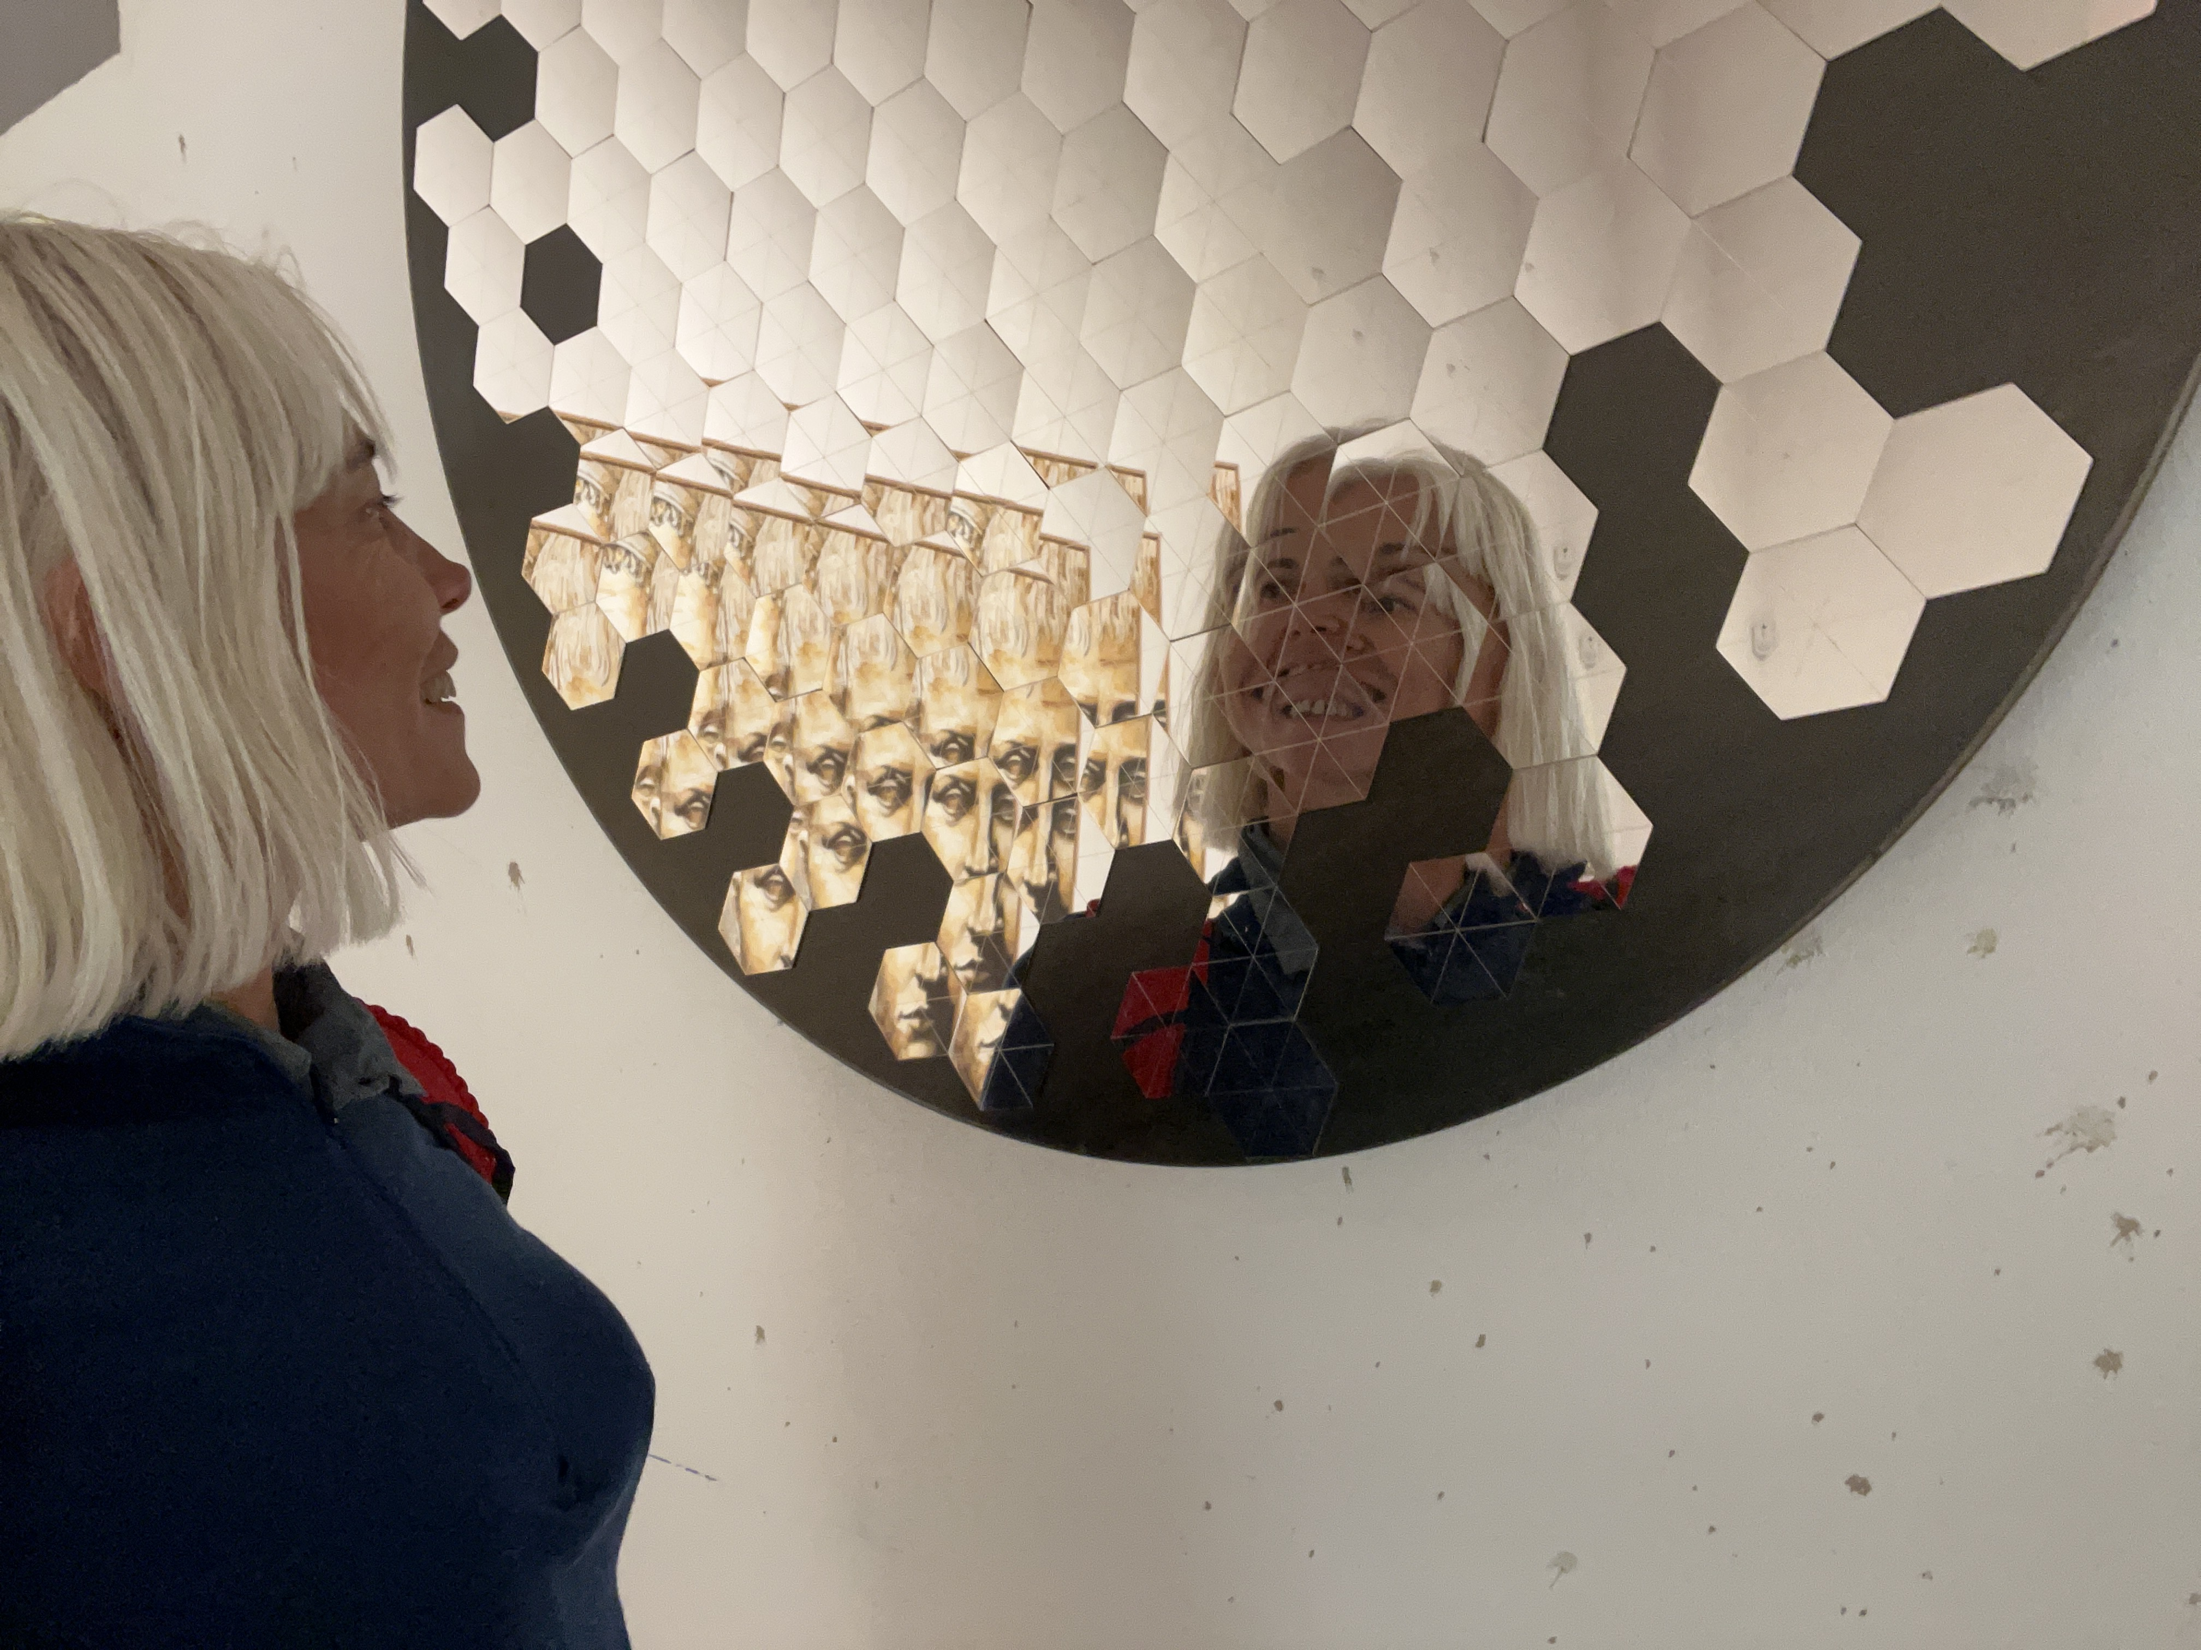

Reflexions about AI in MED
Michela Chessa & Agnès Festré
2022
GREDEG Interdisciplinary Workshop on AI
December 9th, 2022
14h45-15h45

Slide 2
General remarks on MED&IA
Theoretical angle:
  investigate the object and research questions related to AI by focusing on decision making in relation with technological artefacts institutions as well as environment.
Methodological angle:
  Modeling and experimental approach
The selection of research work and projects deals with:
  Understand human behavior in interaction with humans and non humans
  Predict decisions
  Acceptability of `decisions’ by non human agents
Notes:
Naturally and logically, the theoretical angle priviledged by the team MED to investigate the object and research questions related to AI is to focus on decision making in relation with technological artefacts institutions as well as environment.
Research topiccs

Slide 3
1. Understand human behavior in interaction with humans and non-humans
Paolo Zeppini
RQ:
  Do trading algorithms make markets more efficient?
    Say yes: the no-trade theorem and the end of finance
    Say no: trading algorithms as behavioural biases amplifiers
Undergoing projects and collaborations:
  Develop Machine Learning versions of statistical arbitrage trading algorithms based on the Error Correction model (collab. with UCA Data Science)
  Experiments with price-extrapolation trading algorithms in the laboratory (LEEN and possible collab. with Osaka University and/or Waseda University, Tokyo)
Notes:
Milgrom-Stockey
No room for noise trading or non rational interferences with prices
Common knowledge
No possibility of profitable informational advantage
Preclude
A testable assumption
Broken down into 2 research projects: one theoretical ; one experimental

Slide 4
1. Understand human behavior in interaction with humans and non humans
Zakaria Babutsidze
RQ:
  Does the interaction with automated bots (AI-operated accounts) on twitter change behavior of the twitter user (on twitter)?
Methods:
  Quasi-experimental design applied to large-scale twitter data
Research work and results:
  Yes, there is a significant and lasting change in terms of twitting frequency, as well as various characteristics of tweet performance (i.e., engagement)

Slide 5
1. Understand human behavior in interaction with humans and non humans
Mathieu Chevrier & Eric Guerci
RQ
  Suppose an algorithm is optimal, will humans follow its advice? Can the algorithm correct human cognitive biases? Or make them even more biased?
  How do humans attribute trust to an AI advisor?
Results
  The rule used by the adviser is an important factor to understand Algorithm Aversion
  There is Algorithm Appreciation in a risky context with an algorithm adviser
  People don’t have the same expectation from an algorithm vs. a human

Slide 6
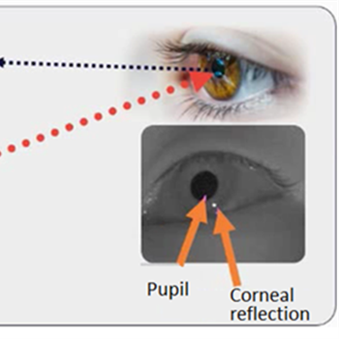
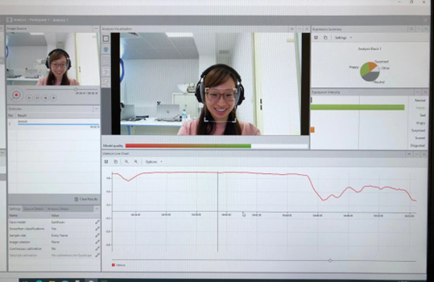
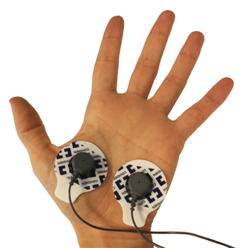
2. Predict decisions
Series of the measurement tools | Measurements
 | Eye-tracking
 | Screen recording and frontal camera recording
 | Facial emotion analysis
 | EDA (Electro Dermal Activity) ECG: Electrocardiography EEG: Electroencephalography
Wenxin Xiong & Eric Guerci
RQ:
  test the hypothesis that people’s feelings/emotions account for their preferences
Method:
  Use of physiological and neural signals, face reading and eye tracking for the participants exposed to an emotional experience
  use of AI (multi-modal NN architecture) to predict decisions (preferences) of experimental participants
Results:
  Encouraging results with video-watching tasks (also in transfer learning)

Slide 7
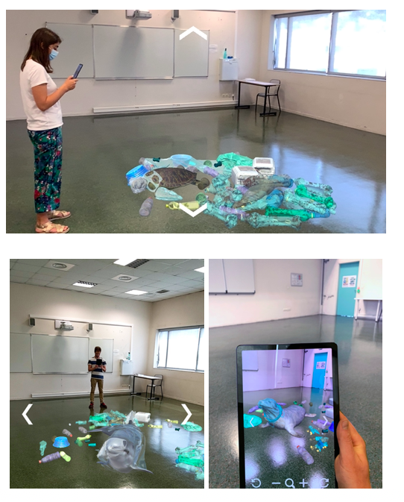
2. Predict decisions
Giuseppe Attanasi, Barbara Buljat & Agnès Festré
RQ:
  How presenting a consequence of plastic pollution in AR format may impact pro-environmental behavior (donation)?
  Effect mediated by psychological distance?
Method:
  Lab and lab-in-the field experiments
Results:
  Null evidence on the relationship between psychological distance and actual pro-environmental behavior measured in voluntary donations.
  Evidence of heterogeneous effect depending on individuals' pro-environmental attitudes and personal characteristics
Notes:
Individuals with low environmental engagement and no previous experience with AR are likely to decrease their psychological distance, while the opposite happened for individuals who are already familiar with AR and engaged in sustainable practices.

Slide 8
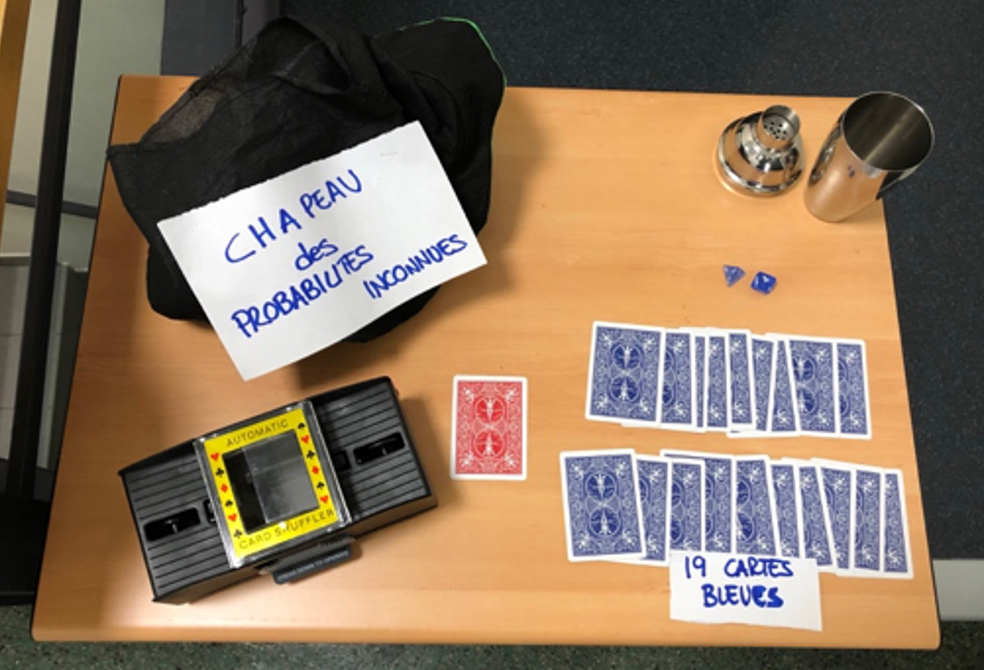
3. Acceptability of ’decisions’ by non human agents
Giuseppe Attanasi & Marta Ballatore & Michela Chessa & Agnès Festré & Chris Ouangraoua
RQ:
  How risk and ambiguity preferences interact with AI experts in a car insurance context
Main result:
  The DM makes decisions based on similar decision problems encountered in the past

Slide 9
3. Acceptability of `decisions’ by non human agents
Ismaël Rafaï
RQ:
  Patients’ acceptability: to what extend people will accept to be tested? (Utility of tests’ privacy, specificity, sensibility, complexity, role of time, risk and social preferences, etc.)
  Physicians’ acceptability : to what extent physician will accept to delegate their expertise to an algorithm?
Large interdisciplinary & international project:
  Biology, Computer Science, Public Health, Economics from France, UK, Sweden, Australia
  Total funding = 1M € including 170k € for Economics (WP4)

Slide 10
3. Acceptability of ’decisions’ by non human agents
Zakaria Babutsidze
RQ:
  Does involvement of AI in the medical procedure change the likelihood of procedure acceptance by humans, and
  Is there a difference whether AI is involved at invasive or non-invasive stage of the procedure?
Results:
  Yes, people are less likely to accept medical procedures where AI is performing a task compared to when the same task is performed by a human doctor. Somewhat surprisingly, this effect is stronger in the case where AI is invoved at the non-invasive stage of the medical procedure.

Slide 11
Links with other teams? Future collaborations?
Acceptability of AI

Slide 12


Slide 13
Reflexions about AI in MED
Michela Chessa & Agnès Festré
2022
GREDEG Interdisciplinary Workshop on AI
December 9th, 2022
14h45-15h45

Slide 14
General remarks on MED&IA
Theoretical angle:
  investigate the object and research questions related to AI by focusing on decision making in relation with technological artefacts institutions as well as environment.
Methodological angle:
  Modeling and experimental approach
The selection of research work and projects deals with:
  Understand human behavior in interaction with humans and non humans
  Predict decisions
  Acceptability of `decisions’ by non human agents
Notes:
Naturally and logically, the theoretical angle priviledged by the team MED to investigate the object and research questions related to AI is to focus on decision making in relation with technological artefacts institutions as well as environment.
Research topiccs

Slide 15
1. Understand human behavior in interaction with humans and non-humans
Paolo Zeppini
RQ:
  Do trading algorithms make markets more efficient?
    Say yes: the no-trade theorem and the end of finance
    Say no: trading algorithms as behavioural biases amplifiers
Undergoing projects and collaborations:
  Develop Machine Learning versions of statistical arbitrage trading algorithms based on the Error Correction model (collab. with UCA Data Science)
  Experiments with price-extrapolation trading algorithms in the laboratory (LEEN and possible collab. with Osaka University and/or Waseda University, Tokyo)
Notes:
Milgrom-Stockey
No room for noise trading or non rational interferences with prices
Common knowledge
No possibility of profitable informational advantage
Preclude
A testable assumption
Broken down into 2 research projects: one theoretical ; one experimental

Slide 16
1. Understand human behavior in interaction with humans and non humans
Zakaria Babutsidze
RQ:
  Does the interaction with automated bots (AI-operated accounts) on twitter change behavior of the twitter user (on twitter)?
Methods:
  Quasi-experimental design applied to large-scale twitter data
Research work and results:
  Yes, there is a significant and lasting change in terms of twitting frequency, as well as various characteristics of tweet performance (i.e., engagement)

Slide 17
1. Understand human behavior in interaction with humans and non humans
Mathieu Chevrier & Eric Guerci
RQ
  Suppose an algorithm is optimal, will humans follow its advice? Can the algorithm correct human cognitive biases? Or make them even more biased?
  How do humans attribute trust to an AI advisor?
Results
  The rule used by the adviser is an important factor to understand Algorithm Aversion
  There is Algorithm Appreciation in a risky context with an algorithm adviser
  People don’t have the same expectation from an algorithm vs. a human

Slide 18
2. Predict decisions
Series of the measurement tools | Measurements
 | Eye-tracking
 | Screen recording and frontal camera recording
 | Facial emotion analysis
 | EDA (Electro Dermal Activity) ECG: Electrocardiography EEG: Electroencephalography
Wenxin Xiong & Eric Guerci
RQ:
  test the hypothesis that people’s feelings/emotions account for their preferences
Method:
  Use of physiological and neural signals, face reading and eye tracking for the participants exposed to an emotional experience
  use of AI (multi-modal NN architecture) to predict decisions (preferences) of experimental participants
Results:
  Encouraging results with video-watching tasks (also in transfer learning)

Slide 19
2. Predict decisions
Giuseppe Attanasi, Barbara Buljat & Agnès Festré
RQ:
  How presenting a consequence of plastic pollution in AR format may impact pro-environmental behavior (donation)?
  Effect mediated by psychological distance?
Method:
  Lab and lab-in-the field experiments
Results:
  Null evidence on the relationship between psychological distance and actual pro-environmental behavior measured in voluntary donations.
  Evidence of heterogeneous effect depending on individuals' pro-environmental attitudes and personal characteristics
Notes:
Individuals with low environmental engagement and no previous experience with AR are likely to decrease their psychological distance, while the opposite happened for individuals who are already familiar with AR and engaged in sustainable practices.

Slide 20
3. Acceptability of ’decisions’ by non human agents
Giuseppe Attanasi & Marta Ballatore & Michela Chessa & Agnès Festré & Chris Ouangraoua
RQ:
  How risk and ambiguity preferences interact with AI experts in a car insurance context
Main result:
  The DM makes decisions based on similar decision problems encountered in the past

Slide 21
3. Acceptability of `decisions’ by non human agents
Ismaël Rafaï
RQ:
  Patients’ acceptability: to what extend people will accept to be tested? (Utility of tests’ privacy, specificity, sensibility, complexity, role of time, risk and social preferences, etc.)
  Physicians’ acceptability : to what extent physician will accept to delegate their expertise to an algorithm?
Large interdisciplinary & international project:
  Biology, Computer Science, Public Health, Economics from France, UK, Sweden, Australia
  Total funding = 1M € including 170k € for Economics (WP4)

Slide 22
3. Acceptability of ’decisions’ by non human agents
Zakaria Babutsidze
RQ:
  Does involvement of AI in the medical procedure change the likelihood of procedure acceptance by humans, and what is there a difference whether AI is involved at invasive or non-invasive stage of the procedure?
Results:
  Yes, people are less likely to accept medical procedures where AI is performing a task compared to when the same task is performed by a human doctor. Somewhat surptisingly, this effect is stronger in the case then AI is invoved at the non-invasive stage of the medical procedure.

Slide 23
Links with other teams? Future collaborations?
Acceptability of AI
Health

Slide 25
Trading Room Robots (Paolo Zeppini)
The quantitative hedge funds industry is on the brink of surpassing $1tn of assets under management this year (Financial Times, 8 January 2018).
At Goldman Sachs, the equity trading desk counted 500 traders in early 2000, and now is made of three people (Bloomberg, 30 April 2018).
Question: Do trading algorithms make markets more efficient?
-> Say yes: the no-trade theorem and the end of finance
-> Say no: trading algorithms as behavioural biases amplifiers
Track 1. Develop Machine Learning versions of statistical arbitrage trading algorithms based on the Error Correction model (collab. with UCA Data Science)
Track 2. Experiments with price-extrapolation trading algorithms in the laboratory (LEEN and possible collab. with Osaka University and/or Waseda University, Tokyo)

Slide 26
LEveraging MEdical REcords to identify patients at risk of Neurodegenerative Disease (LEMEREND) Ismaël RAFAÏ
Aim: Develop early detection algorithms of the risk to develop neurodegenerative diseases (e.g. Parkinson disease, Alzheimer disease, etc.), using personal health data (e.g. “Assurance Maladie”)
Large interdisciplinary & international project.
  Biology, Computer Science, Public Health, Economics from France, UK, Sweden, Australia
  Total funding = 1M € including 170k € for Economics (WP4)
WP4: Studying the acceptability and the value of those early detection algorithms
  Patients’ acceptability: to what extend people will accept to be tested? (Utility of tests’ privacy, specificity, sensibility, complexity, role of time, risk and social preferences, etc.)
  Physicians’ acceptability : to what extent physician will accept to delegate their expertise to an algorithm?
  Economic value : What is the value of those tests for the economy ?
  Methods: Theoretical analysis; Experiments (in general population and with physicians); Micro-simulations.

Slide 27
Paper 1: Human decision-making in the presence of algorithm adviser:
An experimental emphasis. by: Chevrier (GREDEG), Corgnet (Emlyon/ GATES-LSE), Guerci (GREDEG) & Rosaz (BSB)
Motivation
In classical economic theory, people are rational and make optimal choices. But we know that in reality people have cognitive bias that prevents them to make optimal choice.
The general idea of this paper is to see if human decision makers are impacted by algorithms adviser.
Research Question :
Will people follow an optimal algorithm adviser ?
Will people follow a biased or a random algorithm adviser ?
Will people prefer to follow a human or an algorithm adviser ? (Contributing to the literature on Algorithm Aversion (Dietvorst et al. 2014))
(Chevrier (GREDEG), Corgnet (Emlyon/ GATES-LSE), Guerci (GREDEG) and Rosaz (BSB))

Slide 28
We show that:
The rule used by the adviser is an important factor to understand Algorithm Aversion.
There is Algorithm Appreciation in a risky context with an algorithm adviser.
People don’t have the same expectation from an algorithm and an human.
  People don’t follow an algorithm adviser who apply the optimal rule because this rule is judged to simple to be correct.
  People follow a biased and a random algorithm adviser who performs worse (than the optimal adviser) because they judge this rule enough complex to be correct.
  People don’t follow human.
  People look for algorithm adviser who seems complex but not a human adviser who seems complex.
- During the task, people learn from the adviser to be more biased but not to be more optimal.
(Chevrier (GREDEG), Corgnet (Emlyon/ GATES-LSE), Guerci (GREDEG) and Rosaz (BSB))

Slide 29
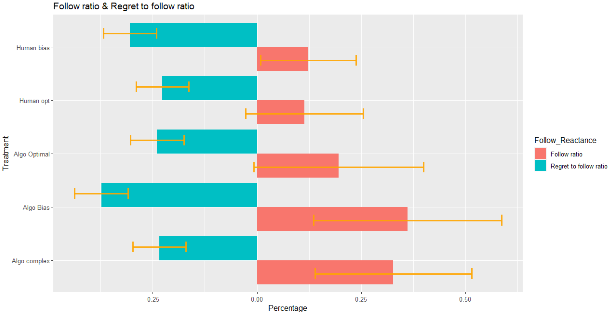
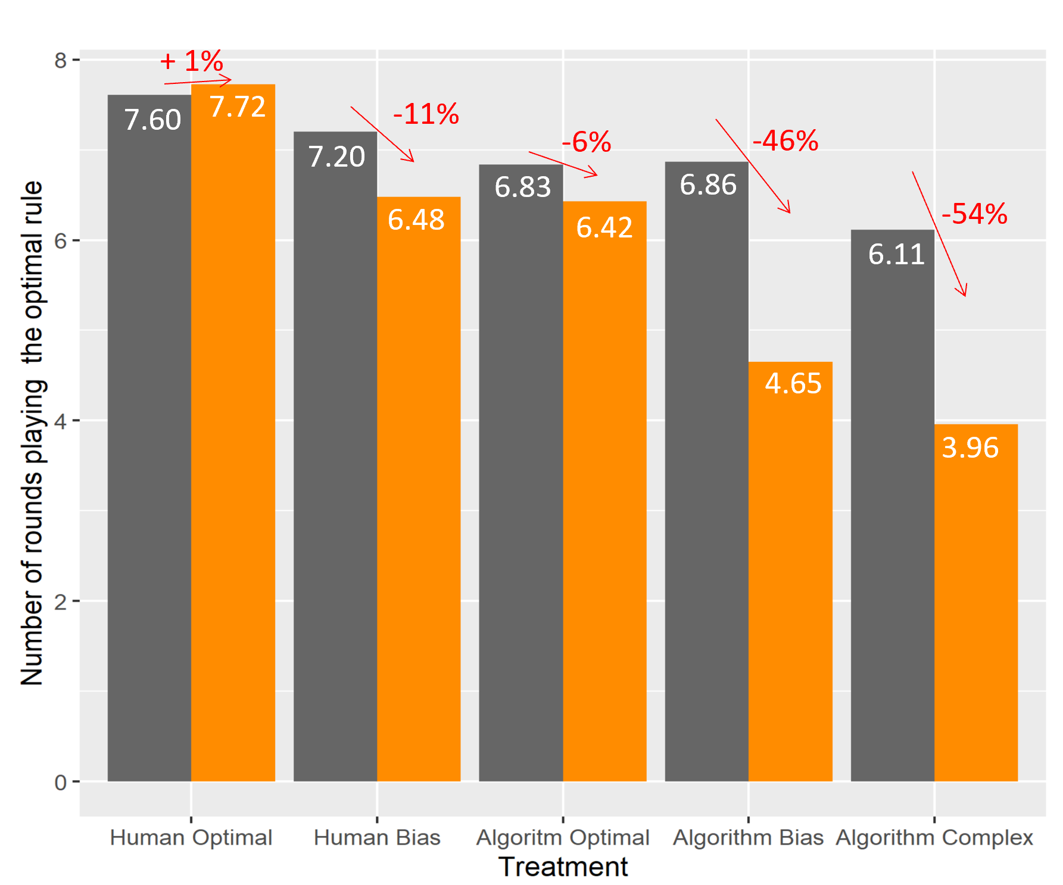


In the graph on the left, we see that people follow the biased and complex algorithmic adviser more than the human. And people have more regrets when they follow a biased algorithm but continue to follow it.
In the graph on the right, we see that people perform worse on average than advisers.
Percentage of the number of times participants follow a counsellor and the regret they feel
Learning to be biased
Before & After :
Before : Taking into account the first 20 rounds
After : Taking into account the last 20 rounds
Wilcoxon test | Algo Opt/Human Opt | Algo Opt/Algo Biased | Algo Biased/Human Biased | Human Opt/Human Biased | Algo opt/Algo random
Follow ratio | 0.01514 * | 0.0001129*** | 2.532e-08 *** | 0.2116 | 9.765e-05 ***
Reactance ratio | 0.5447 | 0.591 | 0.03504 . | 0.05942 | 0.3126
(* Chevrier (GREDEG), Corgnet (Emlyon/ GATES-LSE), Guerci (GREDEG) and Rosaz (BSB))

Slide 30
Paper 2: Metacognition, overconfidende and algorithm (AI) adviser
by: Chevrier (GREDEG) & Massoni (BETA))
Work in progress (start in October 2022)
Motivation :
When a person receives advice after making a choice, his level of confidence is affected. His level of confidence can be translated into economics by the subjective probability that he believes an event will occur.
Research Question :
Can an algorithm better influence the level of confidence of an individual than another human having the same observed performance?
AI algorithms evolve over time and improve. Are humans able to recalibrate their confidence level as an algorithm progresses?
Example: Google's translation algorithm has made big progress over the past 15 years, but many people still think it's inefficient.
Will an inefficient algorithm that is now good, influence an individual's level of confidence more? And will the individual follow it more?
And at reverse, will an efficient algorithm that is now bad, influence an individual's level of confidence less ? And will the individual follow it less?
(* Chevrier (GREDEG) & Massoni (BETA))

Slide 31
The impact of Augmented Reality (AR) on pro-environmental behavior
Barbara Buljat Raymond, 4th year PhD student, GREDEG
Supervised by prof. Agnès Festré and prof. Lise Arena

Slide 32
PhD thesis
Combining qualitative (focus groups, interviews) and quantitative (lab experiment) methods in the process of designing, developing and evaluating a new green IT solution – pro-environmental Augmented Reality experiences that aim to motivate individual eco-friendly behavior

Slide 33
The experiment
We conducted an experiment to investigate how presenting a consequences of plastic pollution in AR format impacts pro-environmental behavior
We compared the effect of AR treatment and no treatment (control), and tested how did the AR experience impact some internal psychological factors that influence pro-environmental behavior, and real pro-environmental behavior (willingness to donate to an environmental organization)

Slide 34



The role of Emotions in economic decision —
Very preliminary Study
Wenxin Xiong, Eric Guerci (GREDEG)
Francois Bremond, Laura Ferrari (STARS, INRIA)

Slide 35
Research Gap
Biosignals in emotion recognition is widely used in psychology and medical research
Emotions are typically extrapolated from facial expressions (video). Recently biosignals have been introduced in the field.
Research gap:
While some analyses display a strong overlap between psychological thinking and economic modelling, in most cases there is still a large gap between economic and psychological approaches to emotion research. (Wälde K, Moors A., 2017)

Slide 36
Research Question
In economics we are interested in what people do in an experiment. We expect thus to estimate their preferences. We put participants in experimental conditions to observe how they make decision.
In our exploratory study, we aim to test the hypothesis that people’s feelings/emotions account for their preferences.
We observe how objects make decision through video watching:
We set up physiological signals, face reader and eye tracker for the participants with an emotional experience.
Then we use machine learning to predict their decision.

Slide 37
Measuring Devices
Series of the measurement tools | Measurements
 | Eye-tracking
 | Screen recording and frontal camera recording
 | Facial emotion analysis
 | EDA (Electro Dermal Activity) PPG: Photo Plethysmogram ECG: Electrocardiography EEG: Electroencephalography

Slide 38
Calibration Videos of Emotional Experience
In our experiment, we take calibration videos from Film Stim, this is a website where links to a database of emotion-eliciting films. we use this part to formalize participants’ emotion.
Positive Emotion (Amusement)
Natural Emotion
Negative Emotion (Fear, Sadness)

Slide 39
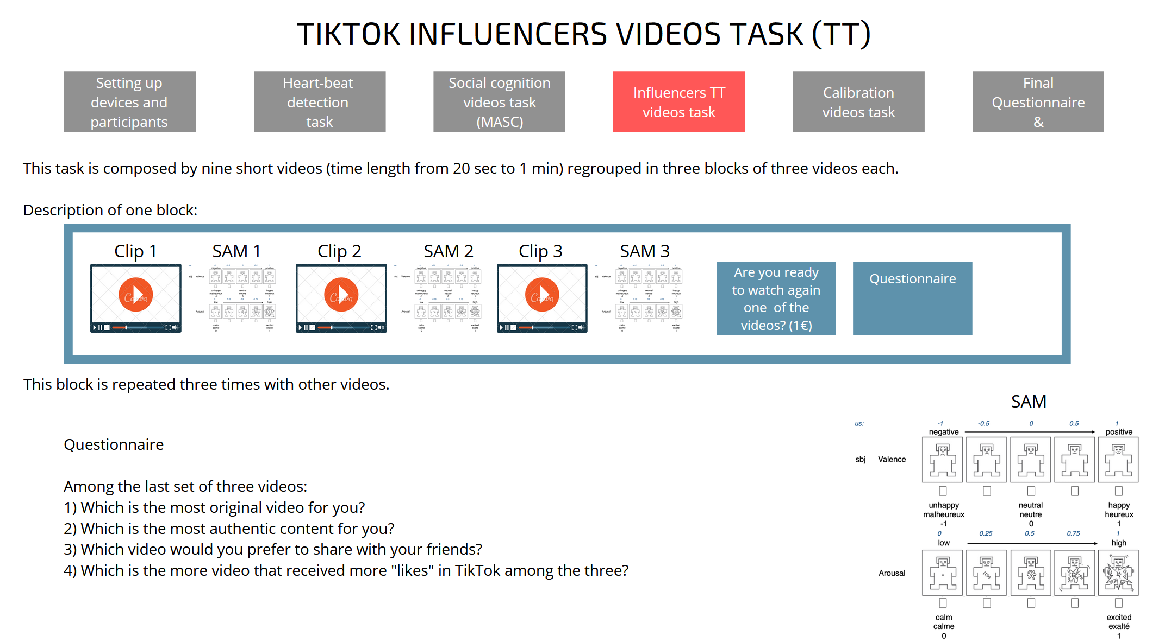
Experiment Design:
    Emotional experience Task
60 participants
（self-assessment manikin）

Slide 40
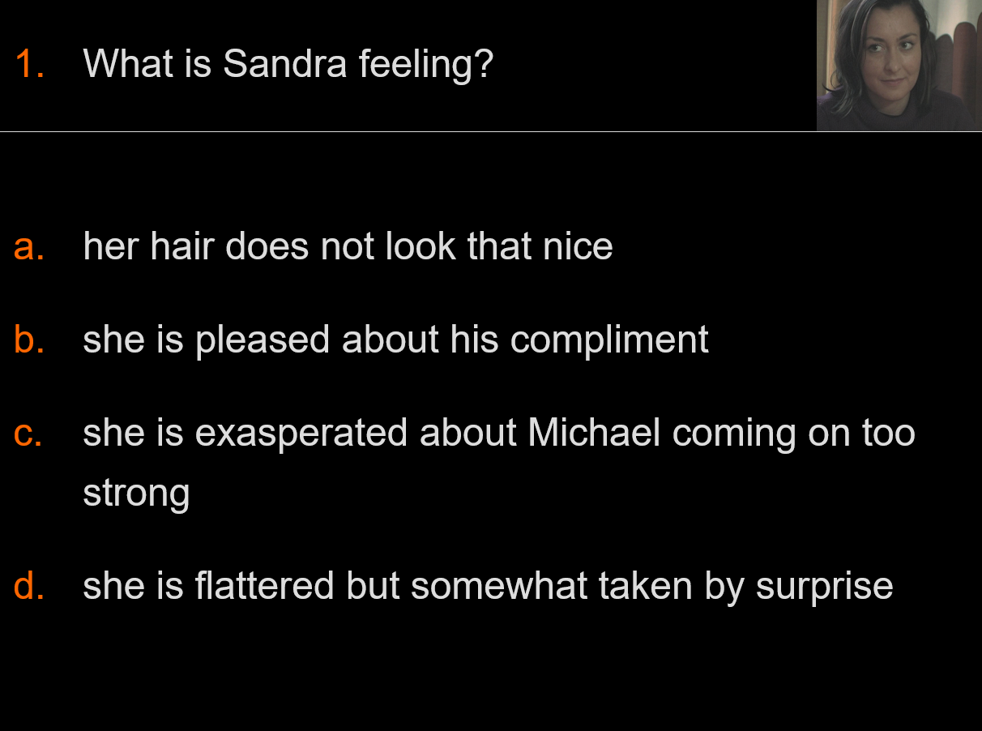
You will be watching a 15 minute film. Please watch very carefully and try to understand what each character is feeling or thinking.
A Movie for the Assessment of Social Cognition (MASC)

Slide 41
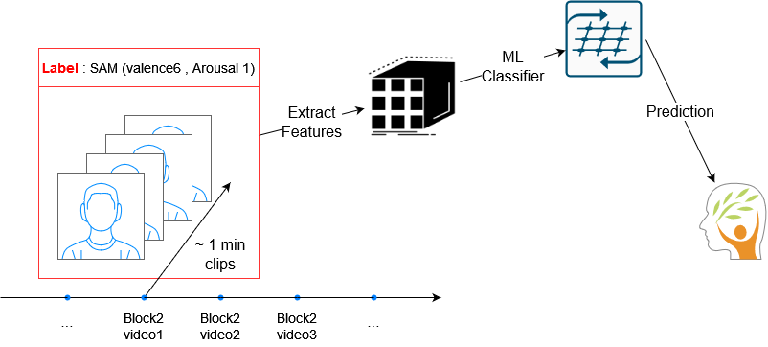
Facial expression

Slide 42
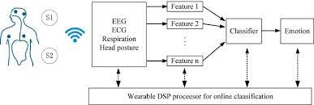
The State of the participants during the emotional experience
PPG
ECG
EDA
Feature 1
Feature 2
ML Classifier
Happy/Sad/Fear/Angry
Feature n
Project : To Classify the Emotions Using PPG, ECG, and EDA/GSR BioSignals

Slide 43
Emotion Features
Machine Learning Pipeline
Final Goal : To Extract the meaningful Features from EEG,ECG, and GSR Bio-Signals
Pre –Pre-processing
Data Normalization
Down sampling (~128Hz)
Filtering
Artifact Removal
Feature –Extraction
Wavelet Transform
time/frequency (statistical, PSD etc.)
Entropy, Energy
Non-linear
Feature – Selection
Relief(Highest value - Weights)
RFE( Sklearn)
Min Redundancy Max Redundancy – MRMR
Effect Size - Based on Feature Selection
Classification Algorithms
ML(SVM, RF, and Boosting Algorithms)
DL(CNN and LSTM etc.)
EEG
ECG
GSR

Slide 44
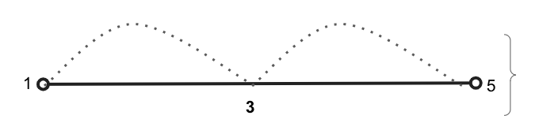
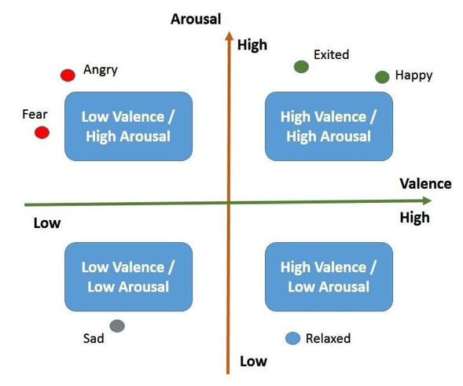
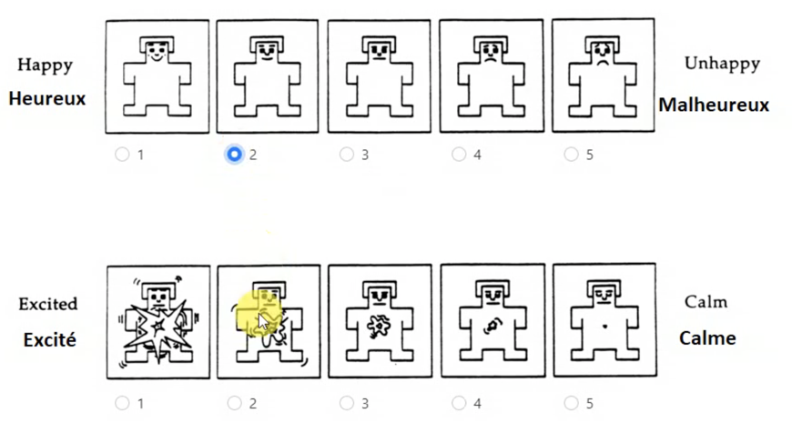
Questionnaire - LUX Label
We have used the Self-Assessment Manikin scale (SAM) to ask the participants their perceived arousal and valence at the end of each video.
We have used these revealed preferences as the ground truth to train the algorithms.
The algorithmic performance refers to the ability of predicting perceived arousal and valence from physiological signals or facial expressions without asking the participant.
Low
High
SAM
Valence
Arousal

Slide 45
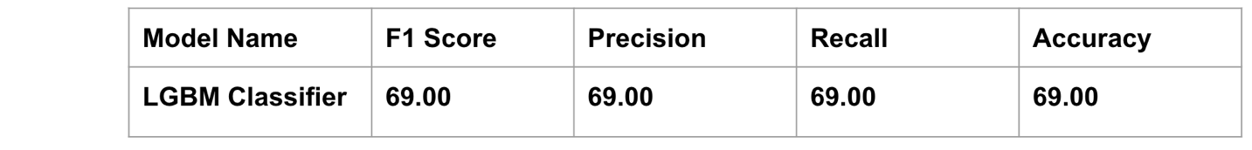
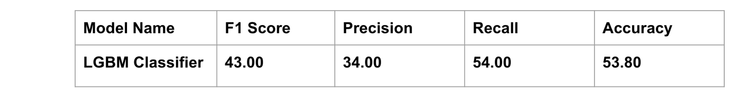
Predicting (out of sample: other subjects) and (out of distribution: other videos) declared valence and arousal through EDA signals. Training the algorithm on AMIGOS dataset and testing the performance on Lux.
Best classifier: LGBM (performance of a random algorithm 25%)

Slide 46
Here it is. I summarised two that are more representative of my future work.
You can copy and paste on any slide that you like:
1. Does the interaction with automated bots (AI-operated accounts) on twitter change behavior of the twitter user (on twitter)?
- Quazi-experimental design applied to large-scale twitter data
- Yes, there is a significant and lassing change in terms of twitting frequency, as well as various characteristics of tweet performance (i.e., engagement)
2. Does involvement of AI in the medical procedure change the likelihood of procedure acceptance by humans, and what is there a difference whether AI is involved at invasive or non-invasive stage of the procedure?
- Experimental methodology
- Yes, people are less likely to accept medical procedures where AI is performing a task compared to when the same task is performed by a human doctor. Somewhat surptisingly, this effect is stronger in the case then AI is invoved at the non-invasive stage of the medical procedure.

